Slide 1
Smart Refrigerators
Team 15 :-
Divyansh Verma
Swapnil More
Vasu Singhal
Amrit Shrivastava
Iman Kalyan
Mentor – Neelesh Sir

Slide 2


Introduction
Food Detection Detect the fruits and vegetables inside fridge
Recipe Suggestions Suggest recipes on basis of available items
Expiry Monitoring Store expiry date of available items
QR code entry manager Detect the date of expiry from QR code scanning.
Motion detection using IR Detect user presence
Voice Interactions Suggest user recipes over a voice and send update on telegram.

Slide 3
Future Scope
Integrating Refrigerator with Smart IOT devices like Alexa/Google Home to perform voice enabled operations.
Collaborating with services like Big Basket, Grofers for automatic ordering of out of stock items
Setting Goals and provide user with calorie analysis of his food habits.

Slide 4
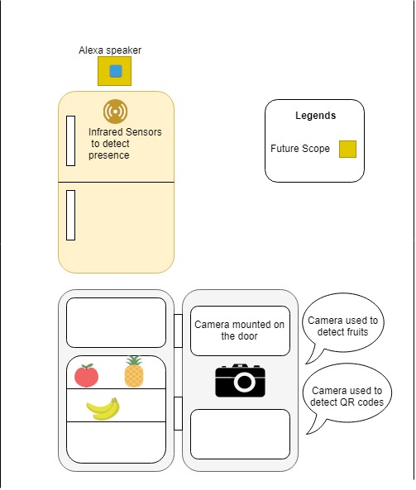
Design

Slide 5
Food detection
The images are extracted from live feed.
Used image captioning , a pre-trained api to detect the items in the image.
The item name are collected from captions using string matching algorithm.
Added the List of items to inventory database.
Api used from DeepAi

Slide 6
QR code entry management
Assume each item has a QR code sticker
Use camera to extract details from QR code using OpenCV, Z Bar and QR tools.
The entry date, expiry date and count of items is calculated from this technique.
If out of stock then redirection link to Amazon for the specified item is provided.

Slide 7
Motion Detection using IR camera and Voice welcoming
The IR camera used to sense the presence
of user near the refrigerator
The detection of users presence triggers
the welcome voice interaction.

Slide 8
Recipe Suggestions
Beautiful Soap library used to find the related recipes based on available items and they are narrated to the user .

